Slide 1

YOUTH CRIME
Year 9 Drama
Lesson 6 – Marcus meets his victim

Slide 2
Lesson Objectives:
To realise the dramatic potential of dialogue
To learn a basic structure of how to write a script including stage directions
To learn about the effect Marcus’s crime had on him and his victim
Some students will try performing a script, following the directions written in front of them.
Notes:
This scheme of work consists of a series of six lessons based on the exploration of youth crime. It is hoped that through practical exploration, students will gain a greater understanding of youth crime, the types of crimes that young people commit, and most importantly why. By the end of this scheme students will understand more about the law and young offenders, and the reasons behind young offenders committing crimes. Throughout these lessons students will be developing drama skills such as scriptwriting and forum theatre. The terminology and skills used are in line with the Edexcel GCSE specification.

Slide 3
Lesson Outcomes:
I will stay in role during tasks/activities/performances.
I will confidently perform a character different to myself during tasks/activities/performances.
I will confidently use drama techniques/mediums (Script/dialogue/use of Space) during my exploration.
I will use P.E.E.E.E.E. when evaluating my own work and the work of my peers.

Slide 4
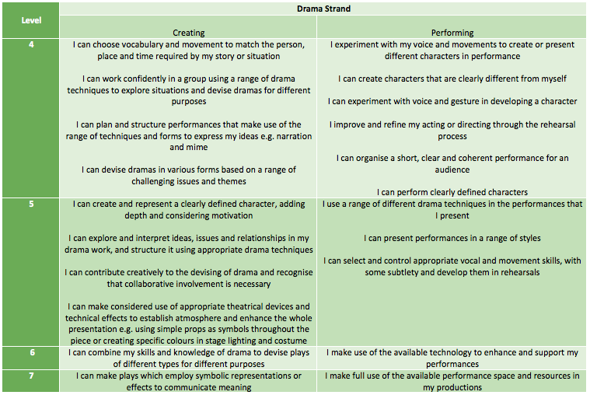
LESSON OUTCOMES

Slide 5
STARTER
3-15 Minutes

Slide 6
THE CHAIRS…
After learning about Marcus over the past few weeks, it is now time for you to decide who his victim was and what crime he committed.
Remember the following points:
Marcus was very young when he hurt the cat
He used his Dad’s walking stick to hurt the cat
He was left on his own a lot
Marcus is not a murderer
GET INTO PAIRS AND FIND A SPACE
Notes:
As students enter two chairs are at the front of the room with ‘Victim’ and ‘Offender’ placards on them. The teacher asks the students to recall who the offender is (Marcus). After learning about Marcus over the past few weeks, it is now time for students to decide who his victim was and what crime he committed. Recap the following points: 1) Marcus was very young when he hurt the cat 2) He used his Dad’s walking stick to hurt the cat 3) He was left on his own a lot 4) Tell the students that Marcus is not a murderer.

Slide 7
TIMED PAIR SHARE
In pairs you have 3 minutes to discuss what crime you think he committed, and then you will feedback answers.
You must discuss the following questions:
How do you think the victim has been affected?
How do you think the offender has been affected?
Notes:
There will undoubtedly be a difference of opinion within the class as to what crime Marcus committed, so it is a good idea to take it to a vote with the best suggestions. (A good conclusion to come to is that Marcus assaulted his father.)

Slide 8
How were they affected?
VICTIM | OFFENDER
Notes:
Noting their ideas down will help with the student modelling exercise and main task later in the lesson.

Slide 9
THE MEETING BEGINS…
Today you will be looking at Marcus’s rehabilitation meeting where he confronts his victim for the first time after the crime.
We need 2 volunteers to take the seats at the front of the class as Marcus and his victim.
The rest of the class will be directing what the still image of the rehabilitation meeting would look like.
Remember to think about how these two characters feel and how this would affect their body language.
Remember the list you just made.

Slide 10
WARM UP
15-25 Minutes

Slide 11
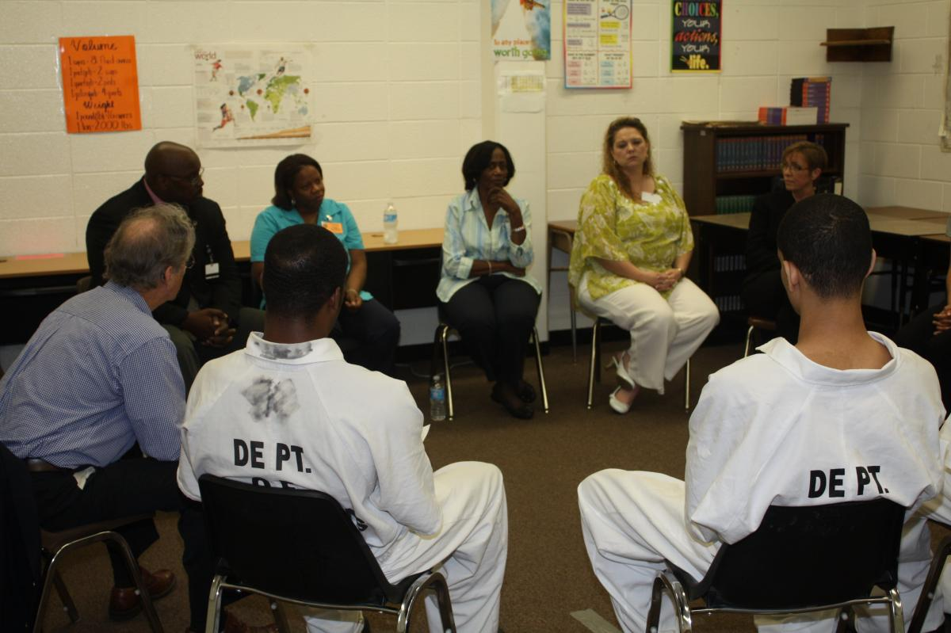
VICTIM/OFFENDER IMAGE
Get into pairs and label yourselves ‘Victim’ and ‘Offender’.
As part of Marcus’ rehabilitation, he needs to meet his victim to think about what effects his actions had.
In pairs, you must create your own still images of what the rehabilitation meeting will look like.
It can be different to the one just modelled.
Students should think about:
Proxemics.
Facial expressions.
Notes:
Remind students to think about how these two characters feel and how this would affect their body language. Draw students’ attention to the table on the board to help them. Only give the students a minute or two to create their still images, as it is important to move onto the next task quickly.

Slide 12
ADD IN SPEECH
Add in a line of dialogue for Marcus and the victim to show how they feel about each other.
Some images will be spotlighted.
Only 1 line each.
I wanted to say…
Notes:
Have sentence starters displayed on the board to assist lower ability students. E.g. Marcus: ‘I want you to know that ….’; Victim: “Do you understand that
….”

Slide 13
QUESTION
Why is dialogue important in a scene?
Dialogue can be used to show the relationship between two or more characters, and help explain to the audience what is happening in the scene.
The sentences you have chosen will create the start of a script you will be writing between the two characters today.

Slide 14
PAIRED WORK
25 - 45 Minutes

Slide 15
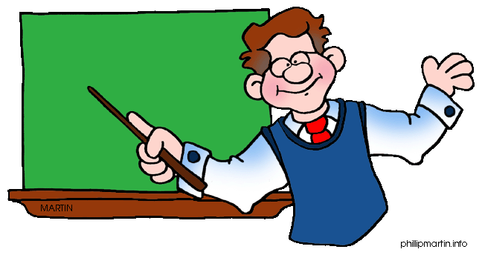
PAIR TASK
You have been given a script writing template.
You can use the table from the start of the lesson to help.
Think about what the characters would want to say to each other.
Notes:
Explain that the boxes are just a suggestion for how long each line should be and they can use the key words to help them. During this exercise it is important to assist students with low literacy skills by providing them with sentence starters. It might be beneficial to have an example of a completed script template to model to them. Alternatively, it may be useful to pair up weaker students with more able students.

Slide 16

ADD IN…
Two pauses
Stage directions.
What effect do pauses have in a scene?
Why do we use stage directions in a scene?
Notes:
Remind them how they used ‘pause’ to build tension in the Young Offender Institution ensemble.

Slide 17
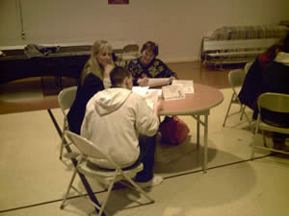
REHEARSAL
“Once scripts are completed students should practice their scene, and any movement on stage needs to be written down in stage directions.”
Notes:
If there is time, or if more than two pairs have completed all of this and rehearsed, they then swap scripts and try to perform each other’s without speaking to the writers. Students do not have to learn their lines off by heart.

Slide 18
PERFORM/EVALUATE
45 - 55 Minutes

Slide 19

PERFORM/FEEDBACK
Some pairs will perform
Students are to give peer feedback using P.E.E.E.E.E
Consider the use of the following techniques and how they benefited the performance, or how they could have improved:
Dialogue, Pause, Stage directions, Body language.
REMEMBER
Point (E)
Example (D)
Explain (C)
Explore (C/B)
Expand (B/A)
Evaluate (A)
Notes:
Have the techniques listed above displayed in the classroom to encourage students to use key words in their evaluations. Weaker students may benefit from some sentence starters here too: ‘I liked the way the group used …because ….’ ‘To improve this group’s performance I would recommend … because ….’ Push students by asking them to justify their opinion of the performance.

Slide 20
PLENARY
55 -60 Minutes

Slide 21
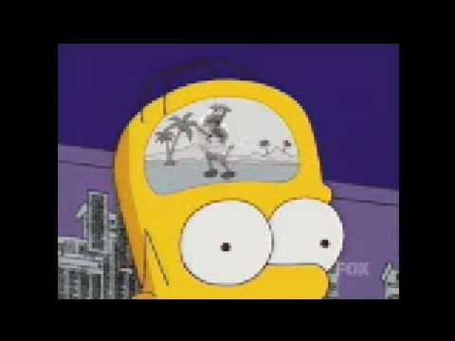
TIMED PAIR SHARE
What did you learn about ‘dialogue’ today?

Slide 22
HOW DID YOU DO TODAY?

Slide 23
LESSON OUTCOMES ADD LEVELS and DIFFERENTIATION
I will stay in role during tasks/activities/performances.
I will perform a character different to myself during tasks/activities/performances.
I will confidently use drama techniques (thought tracking/still image) during my exploration.
I will use P.E.E.E.E.E. when evaluating my own work and the work of my peers.

